Slide 1

Extending Spatial Capture-Recapture with the Hawkes Process
Alec van Helsdingen
Supervisors: Charlotte Jones-Todd and Russell Millar

Slide 2
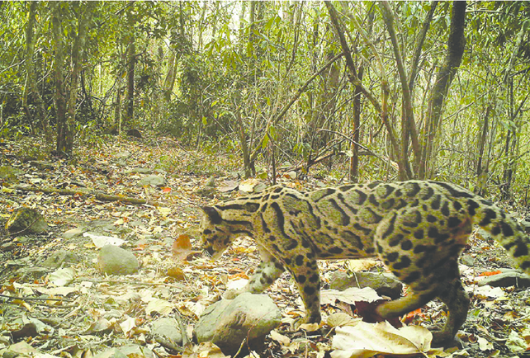
Spatial Capture-Recapture (SCR)
SCR is a method for estimating animal populations.
It can be used when detectors are placed at known locations and individuals can be distinguished when they are detected.
Captures can be made by various methods including trapping, microphones and hair snares.
We will focus on camera-trap surveys in continuous time.
Image Credit: Clouded Leopard co-exists with six other felids in Royal Manas National Park, Bhutan Dhendup et al, 2016

Slide 3
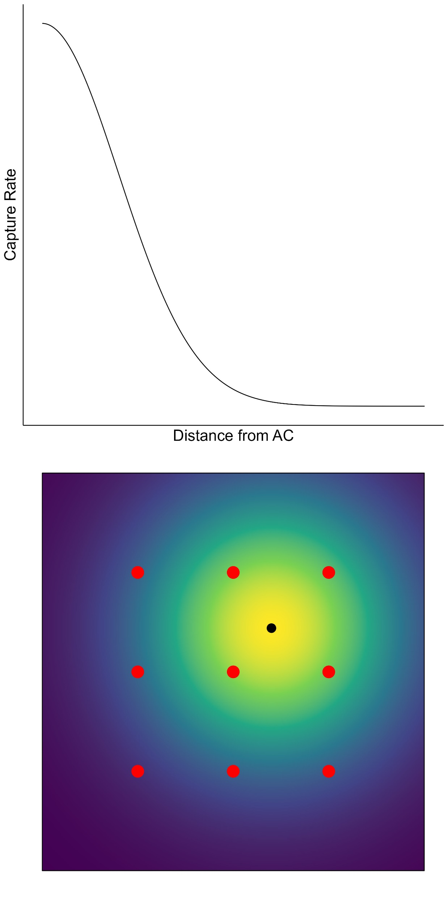
SCR Assumptions
Each individual has a latent activity center.
A detection function relates detection rate to the distance between a detector and the AC.
Detection counts have a Poisson distribution.
Notes:
We can assume for simplicity a constant density of ACs, or use covariates

Slide 4
SCR Assumptions
Each individual has a latent activity center.
A detection function relates detection rate to the distance between a detector and the AC.
Detection counts have a Poisson distribution.
The activity centers are a realisation of a spatial point process.
All detections and activity centers are conditionally independent.
We assume a closed population.
Notes:
We can assume for simplicity a constant density of ACs, or use covariates

Slide 5
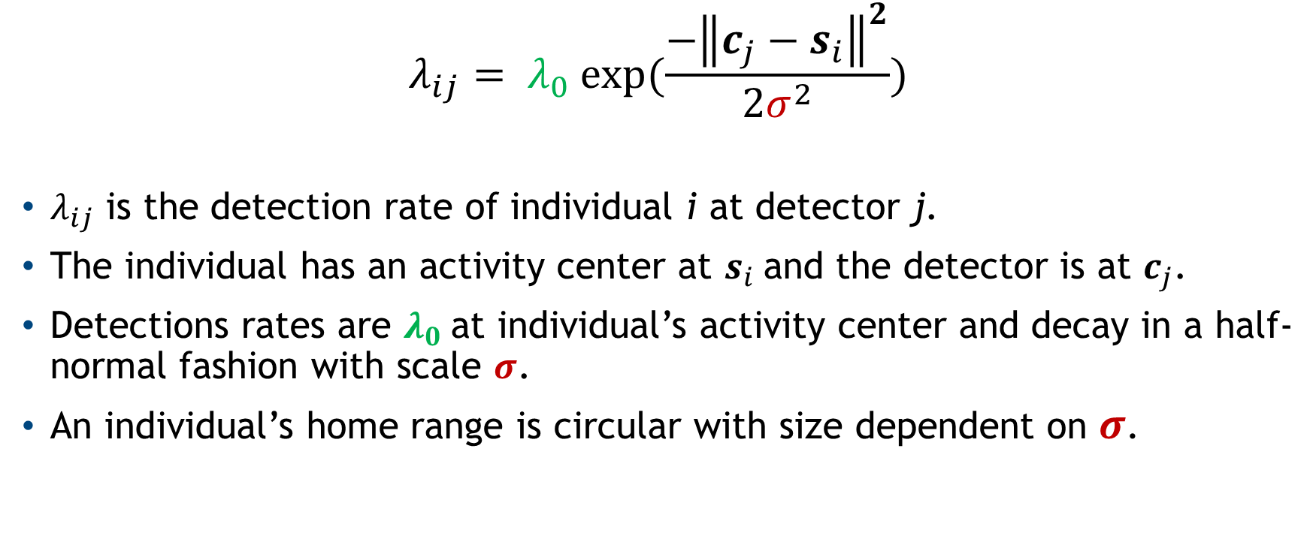
Basic SCR Formulation
$$λ_{ij}= λ_{0} exp⁡(\frac{{−\left\|c_{j}−s_{i}\right\|}^{2}}{2σ^{2}})$$
$λ_{ij}$ is the detection rate of individual i at detector j.
The individual has an activity center at $s_{i}$and the detector is at $c_{j}$.
Detections rates are $λ_{0}$at individual’s activity center and decay in a half-normal fashion with scale $σ$.
An individual’s home range is circular with size dependent on $σ$.

Slide 6
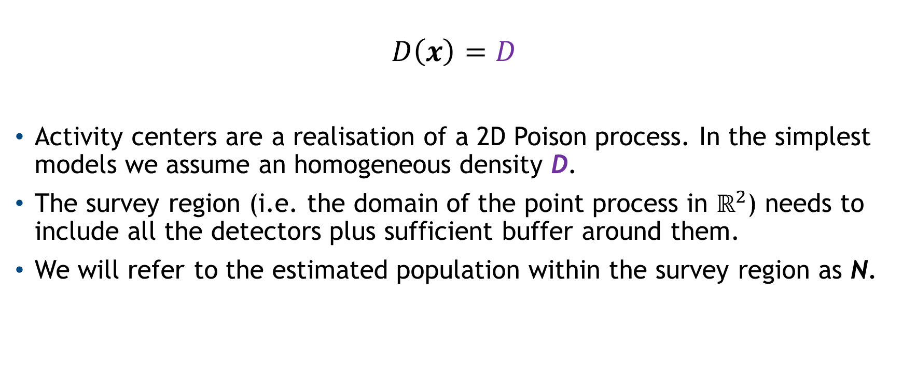
Basic SCR Formulation II
$$D\left(x\right)=D$$
Activity centers are a realisation of a 2D Poison process. In the simplest models we assume an homogeneous density D.
The survey region (i.e. the domain of the point process in $ℝ^{2}$) needs to include all the detectors plus sufficient buffer around them.
We will refer to the estimated population within the survey region as N.

Slide 7
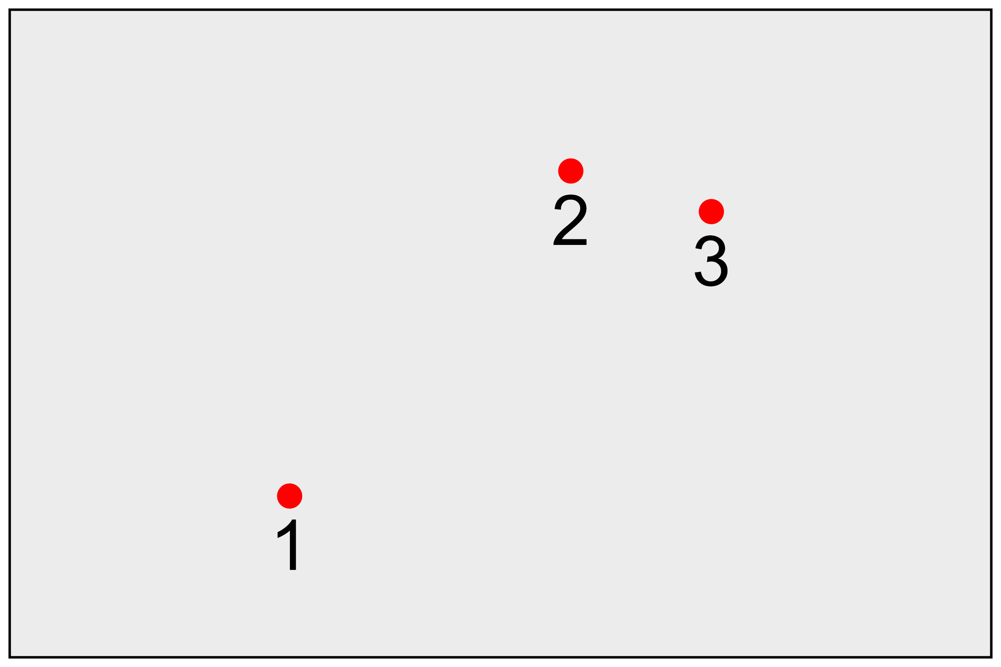
Sample Data
Animal ID | Camera ID | Time (e.g. days)
1 | 2 | 1.2
2 | 1 | 2.8
1 | 3 | 3.1
2 | 1 | 4.2
Detection Information
T=5
Survey Duration
Camera Locations and Survey Region

Slide 8
Animal Movement
SCR assumes independence between all detections.
This may make sense between individuals if the species is solitary.
But it is more questionable for captures of the same individual.
Individuals must move in a continuous path. Thus there is correlation between captures close together in time.

Slide 9
Hawkes Process
The Hawkes Process is based on the idea of self-excitement, meaning one event causes more events in the future.
Commonly applied in seismology and epidemiology.
We expect more SCR captures close in space and time to a past capture, which is what the Hawkes process assumes.
We will use the Hawkes process as a model for this dependence between captures of the same individual.

Slide 10
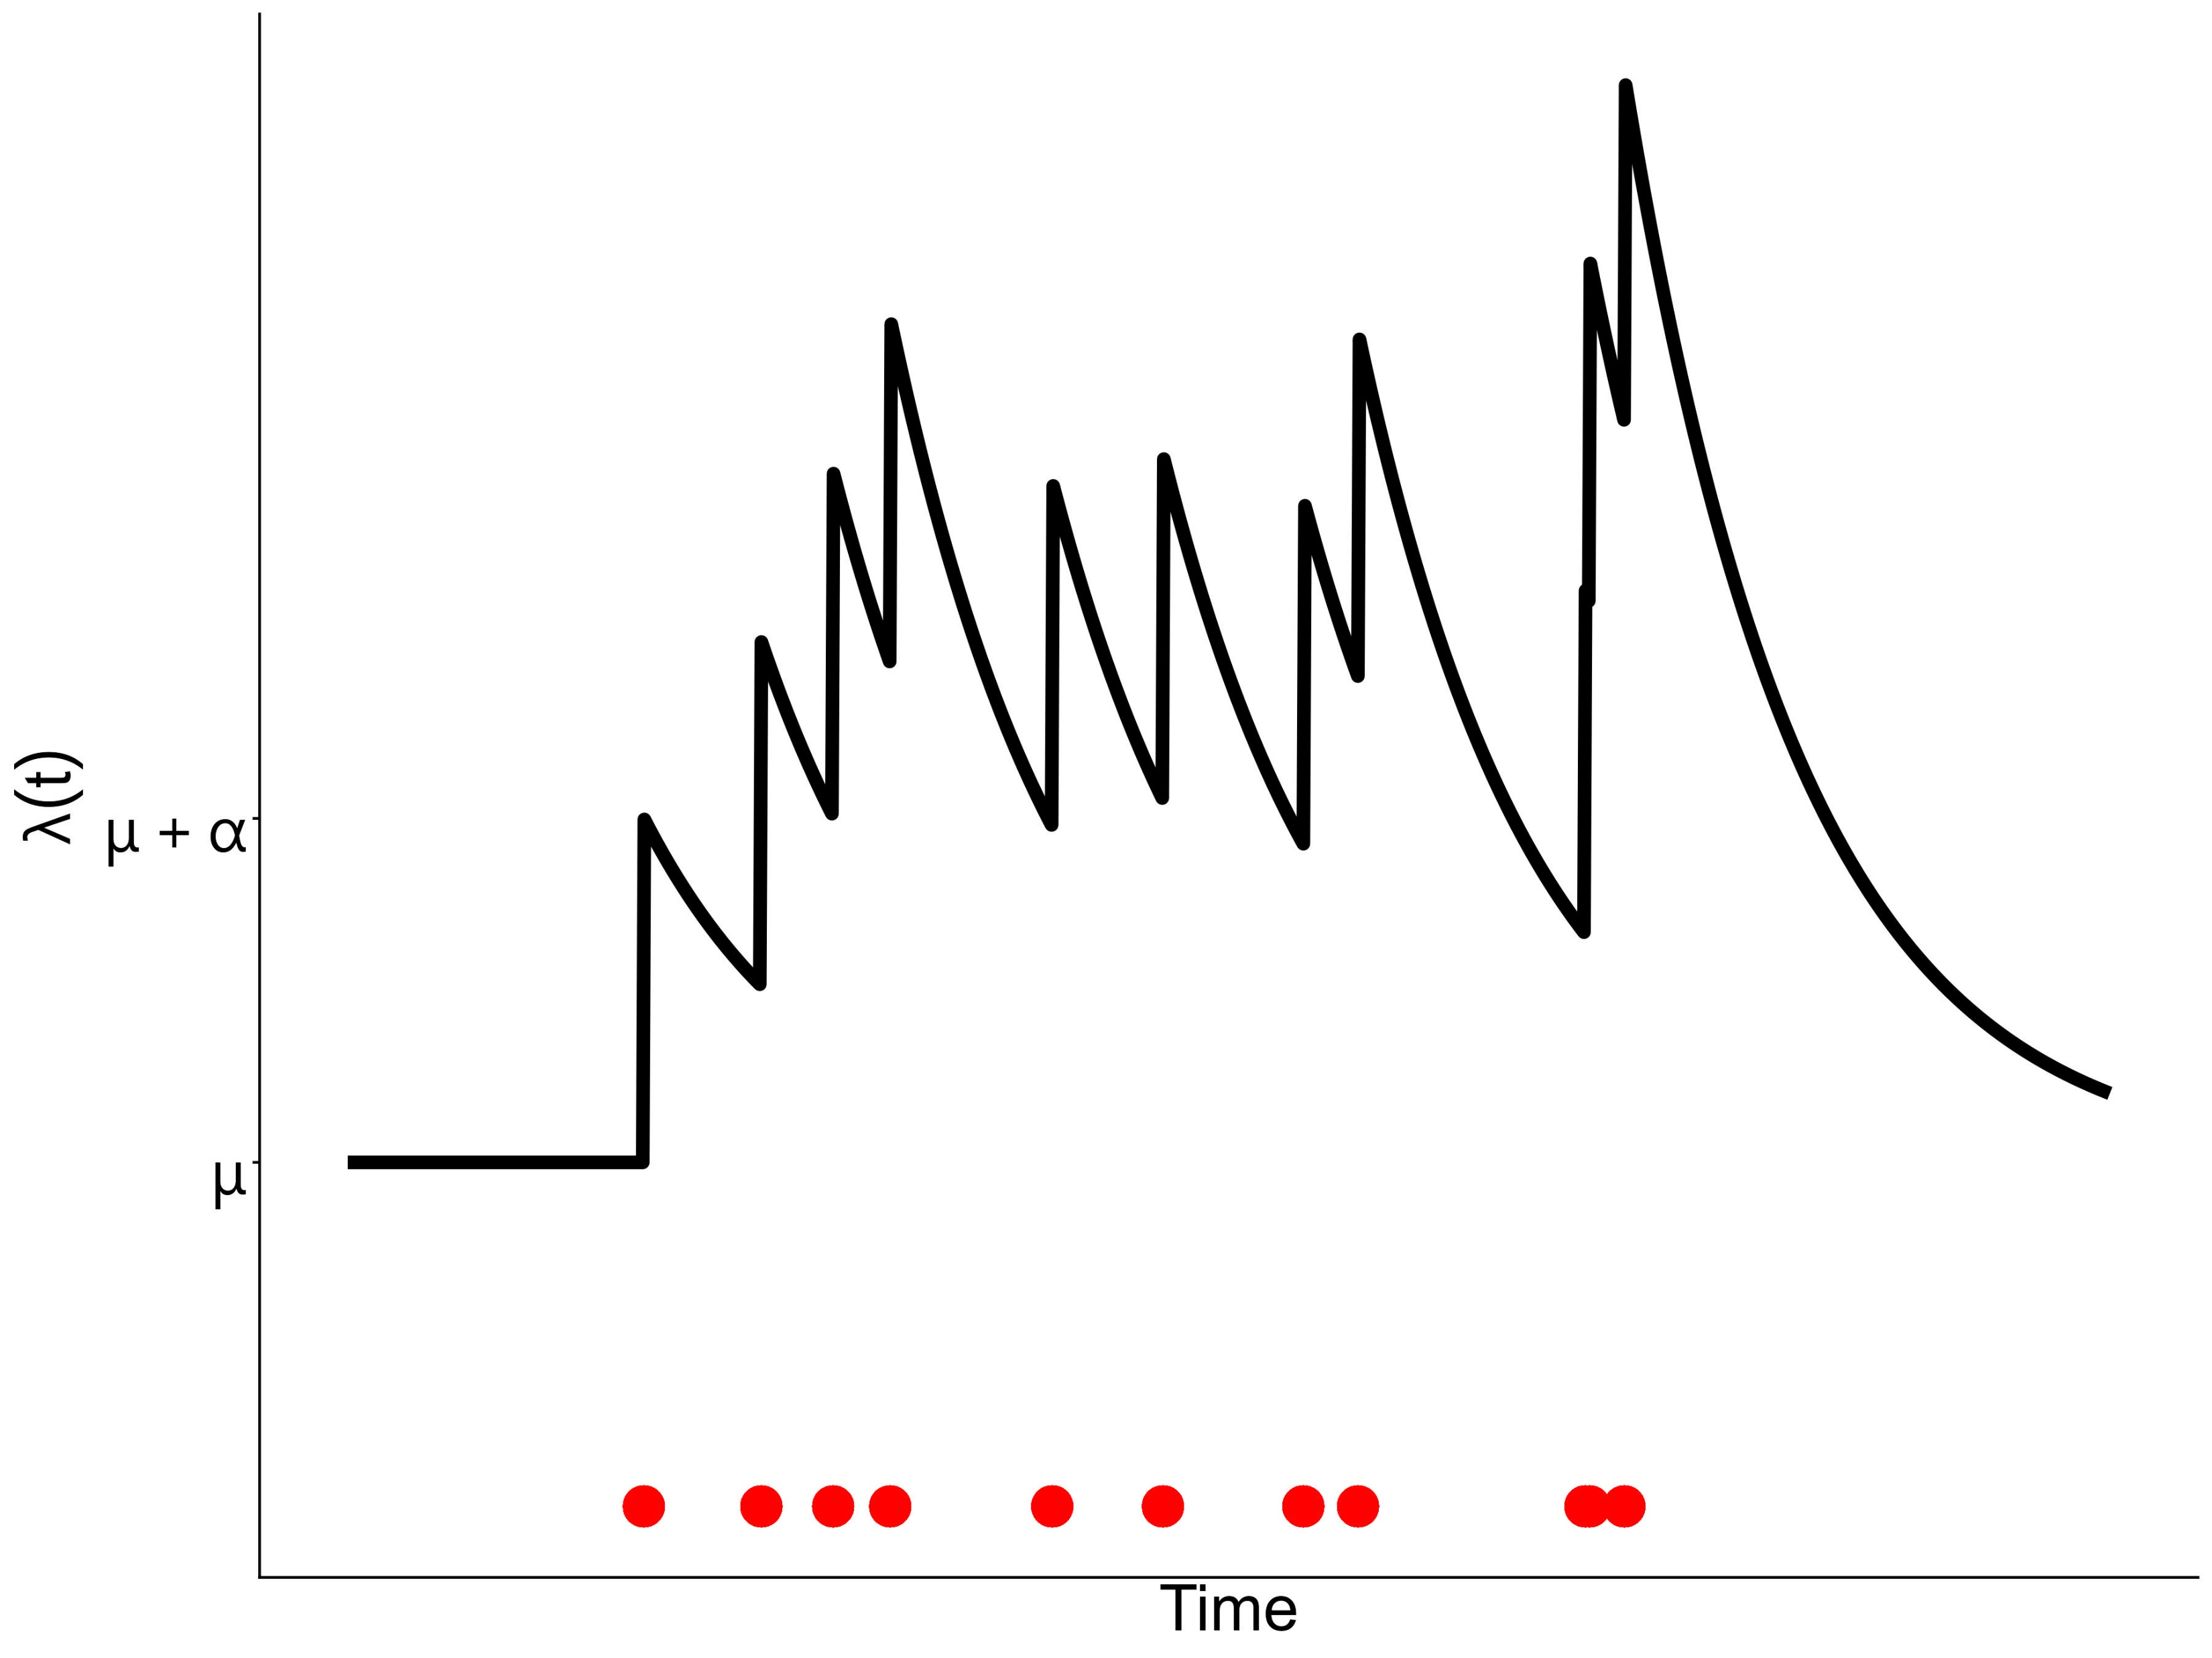
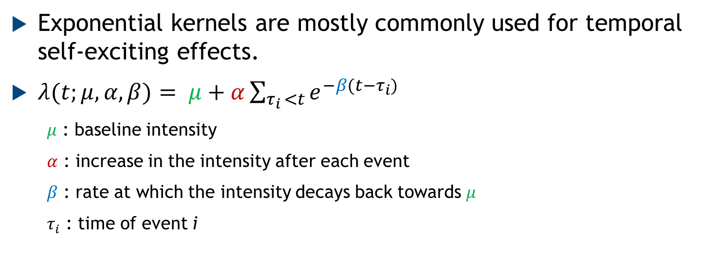
Hawkes Process: Time
Exponential kernels are mostly commonly used for temporal self-exciting effects.
$λ(t;μ,α,β)= μ+α\sum_{τ_{i }<t}{e^{−β(t−τ_{i})}}$
$μ$ : baseline intensity
$α$ : increase in the intensity after each event
$β$ : rate at which the intensity decays back towards $μ$
$τ_{i}$ : time of event i

Slide 11
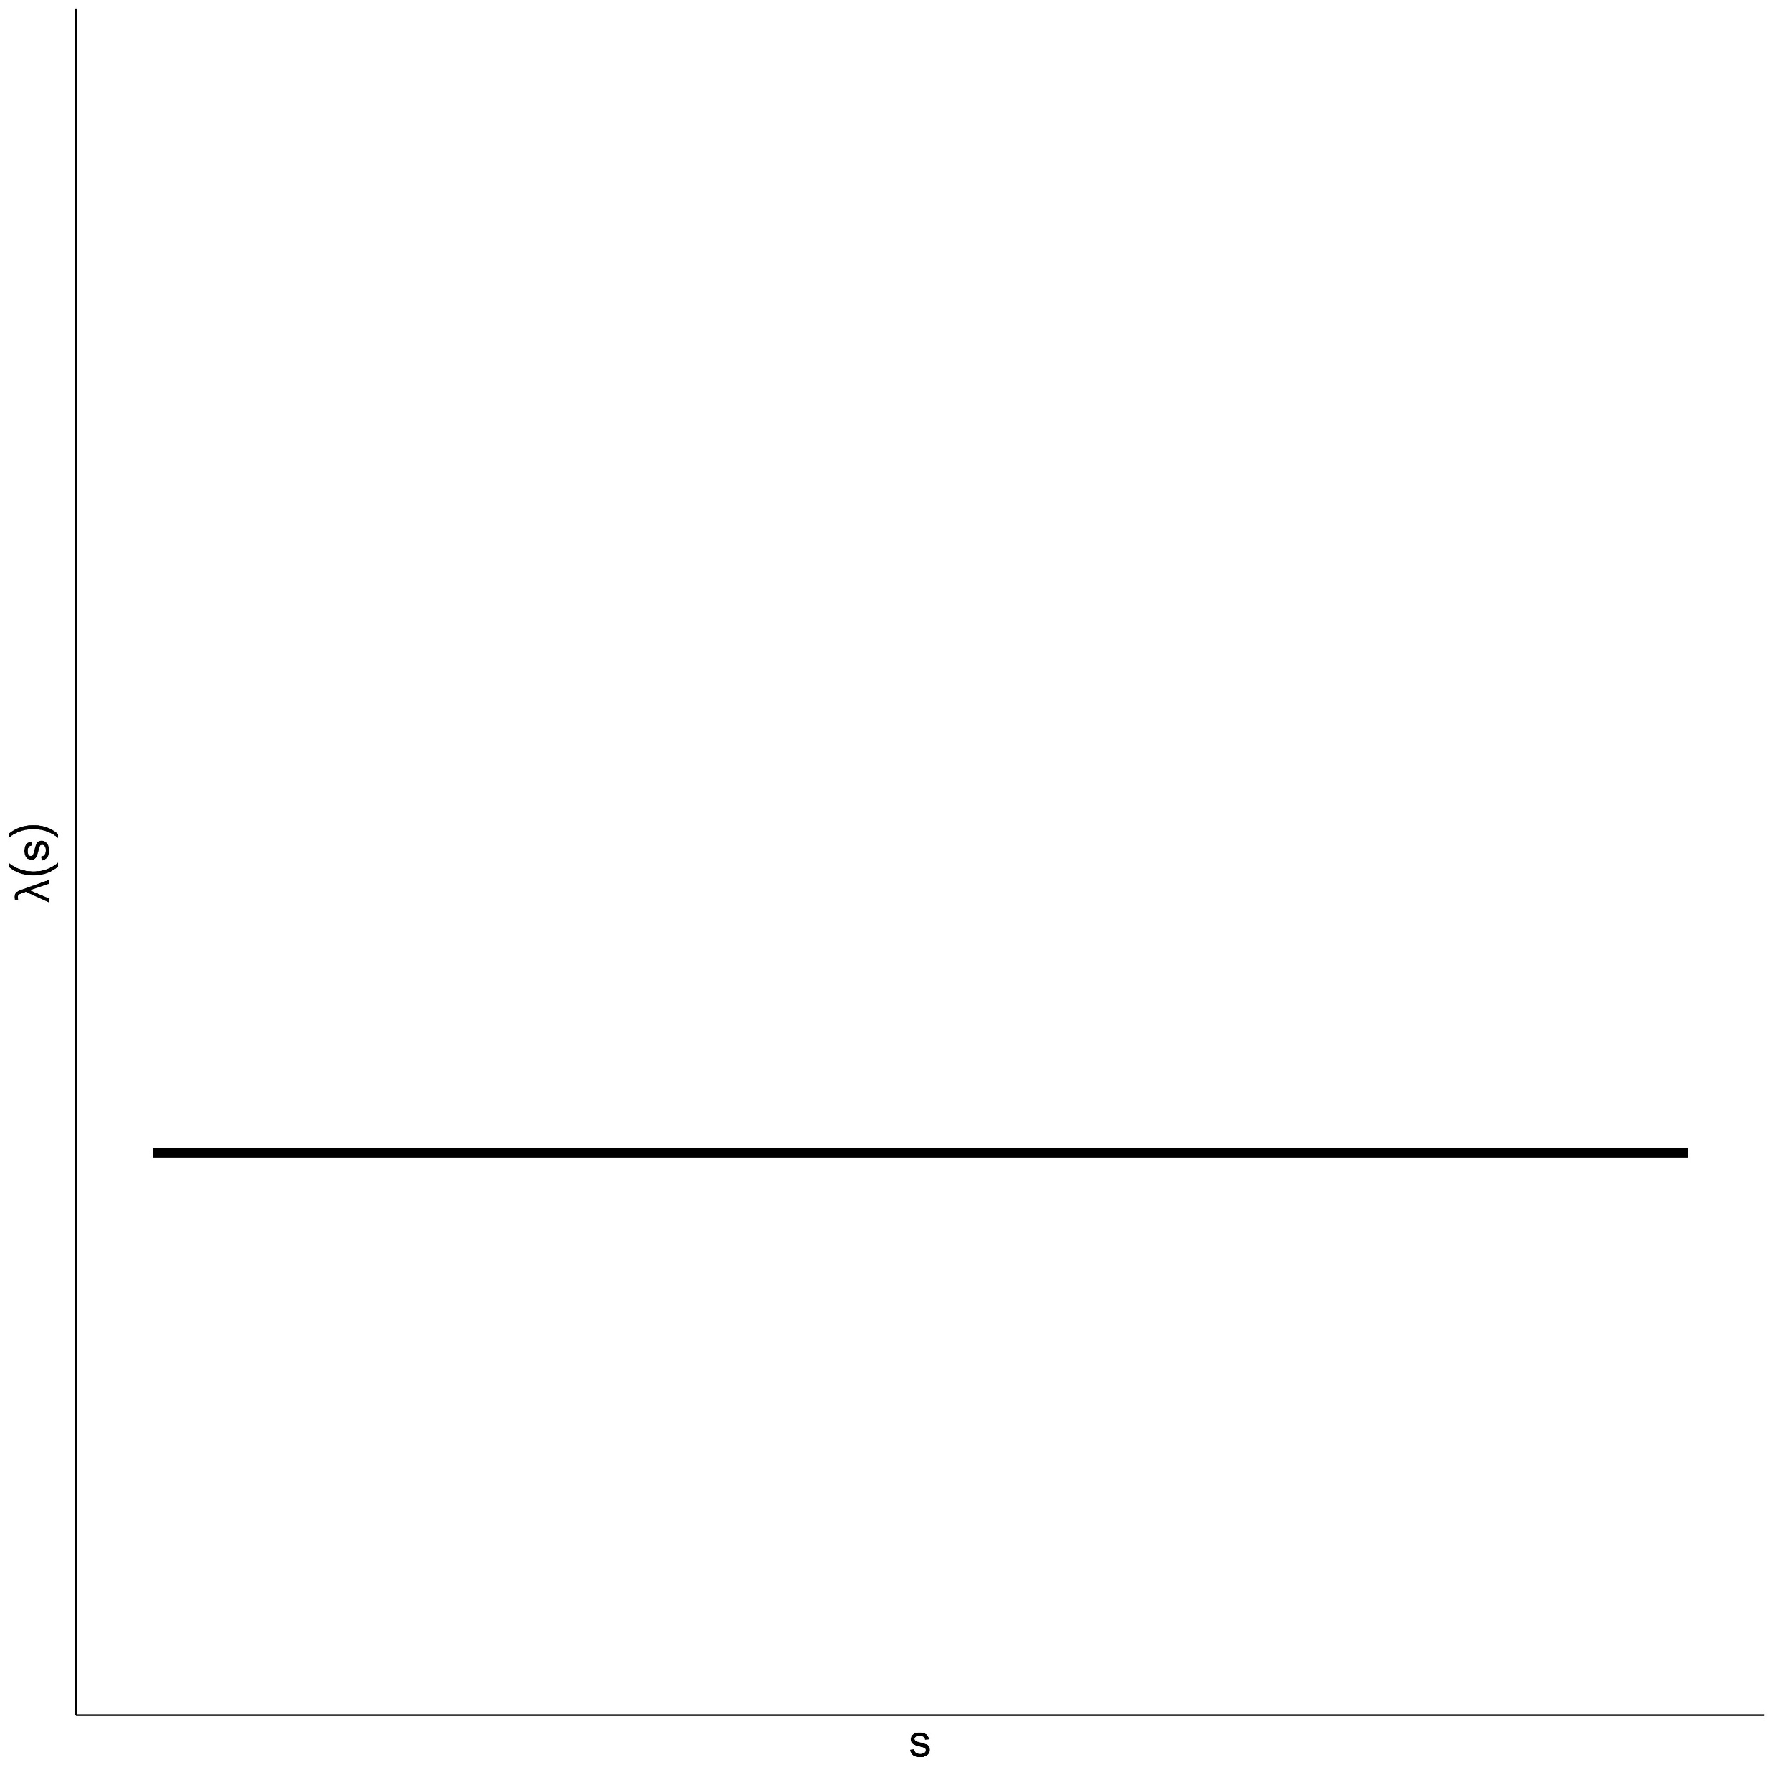
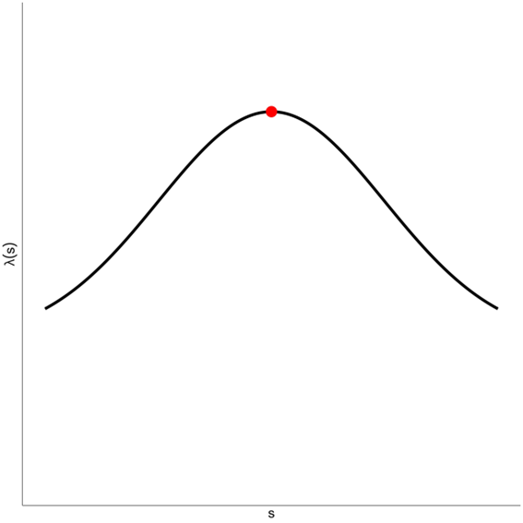
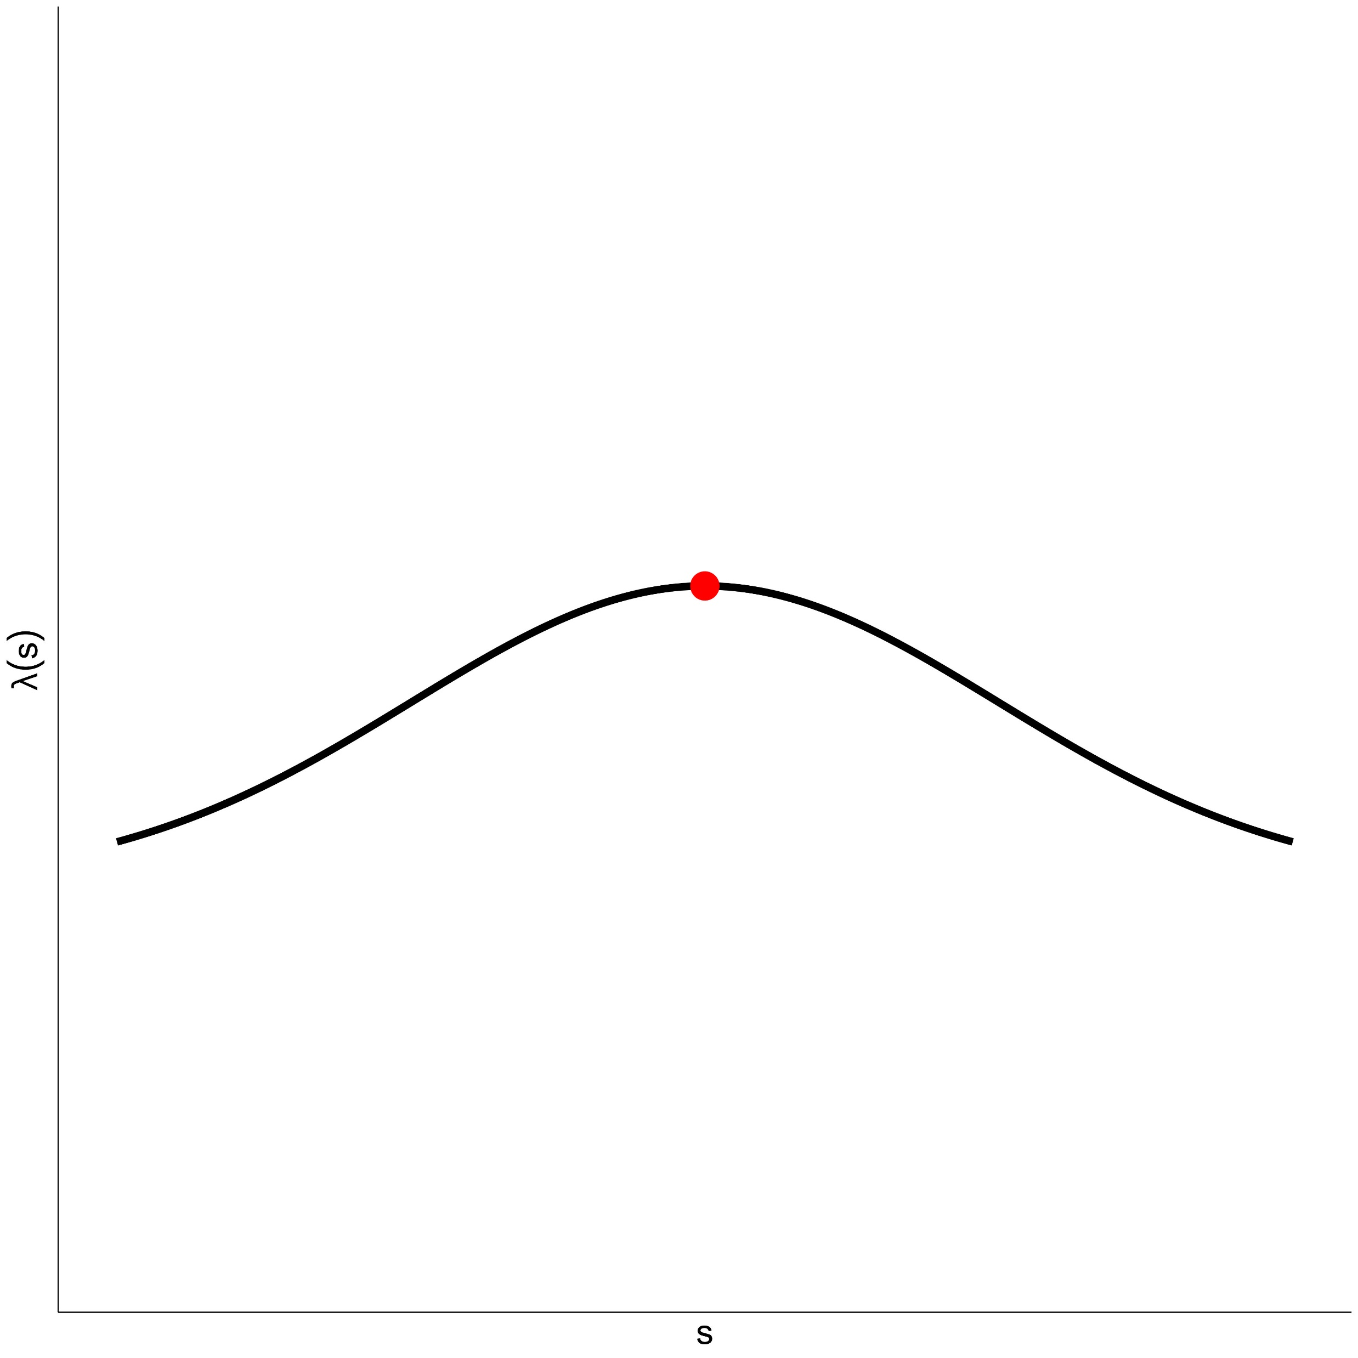
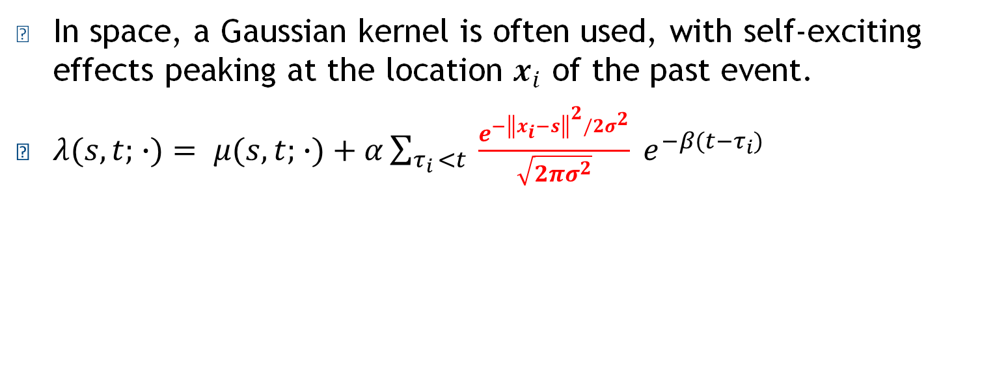
Hawkes Process: Space
In space, a Gaussian kernel is often used, with self-exciting effects peaking at the location $x_{i}$ of the past event.
$λ(s,t; ∙)= μ(s,t; ∙)+α\sum_{τ_{i }<t}{ \frac{e^{{−\left\|x_{i}−s\right\|}^{2}/2σ^{2}}}{\sqrt{2πσ^{2}}} e^{−β(t−τ_{i})}}$

Slide 12
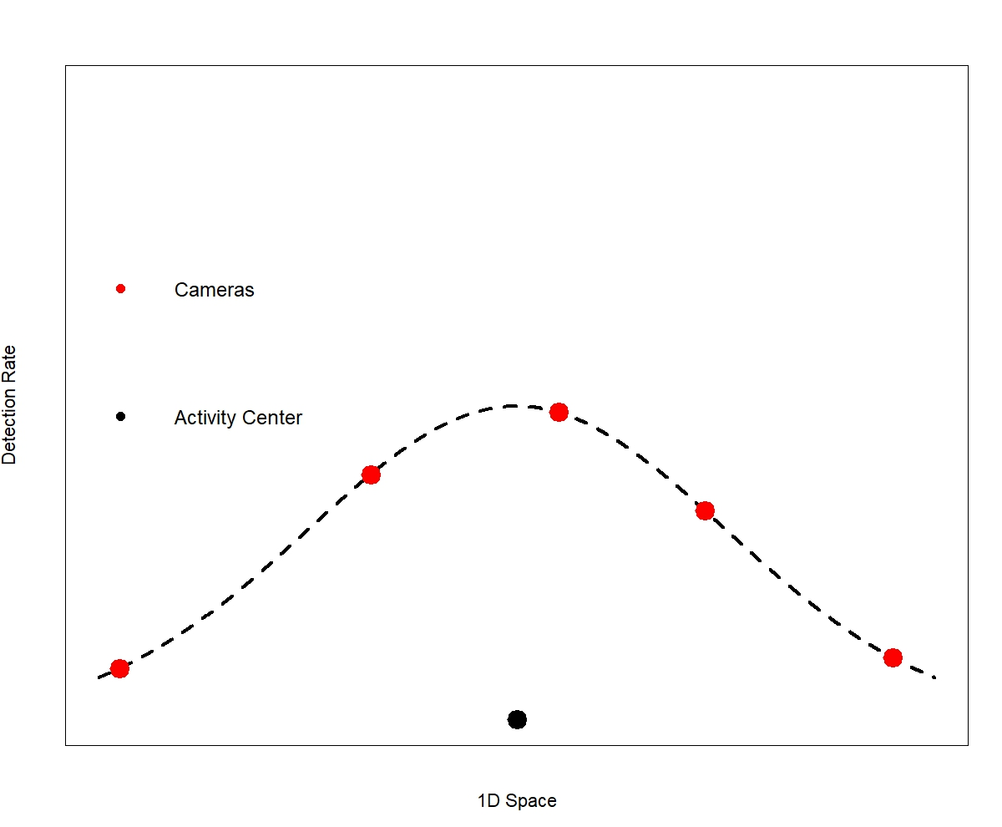
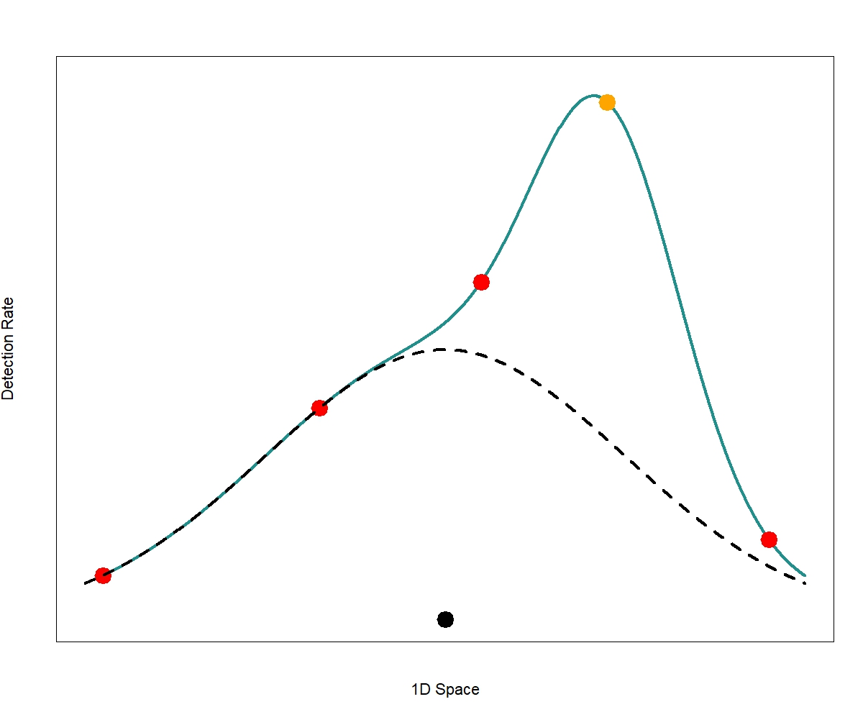
Simple Hawkes SCR Model
Kolev, A. A. (2020). Extensions of Self-Exciting Point processes with Applications in Seismology and Ecology. PhD thesis, University College London
No previous detections
After detection at

Slide 13
Implications of this Model
Here there is a Gaussian function for the baseline function 𝜇(𝑠,𝑡; ∙) and after a detection we have Gaussian “spikes” added to it.
This means the detection rate increases at every camera after a detection.
However we expect that the rate should decrease for cameras furtherer away.
This implies that animals move faster post-capture.

Slide 14
Our Model - SESCR
Instead of adding spikes, we model detection rates as a mixture of the baseline and the spike from the most recent detection.
If detection rates were defined at all points, the 2D integral is constant.
This makes the model Markovian and no longer a true Hawkes process, but the idea of self-excitement and the exponential decay is retained.

Slide 15
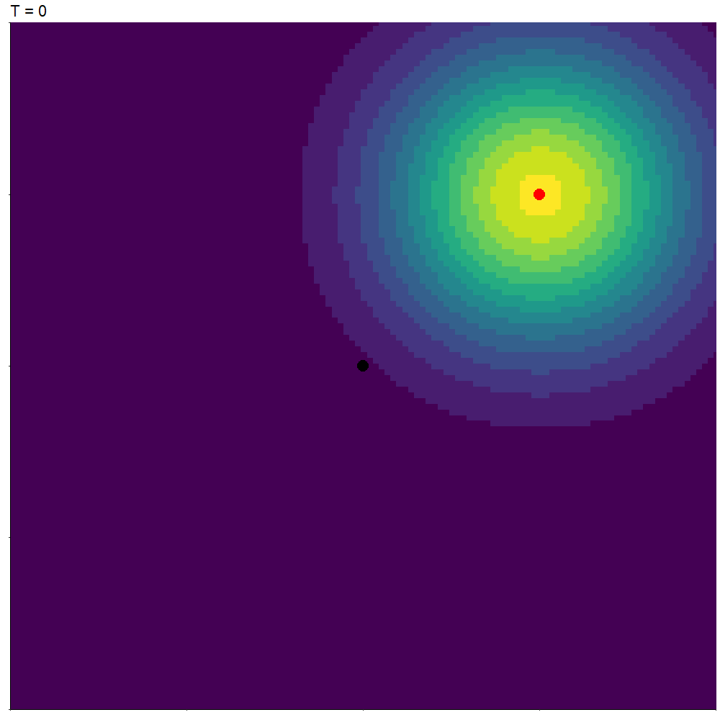

Slide 16
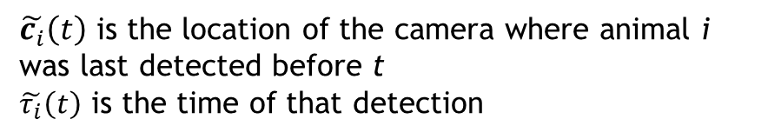
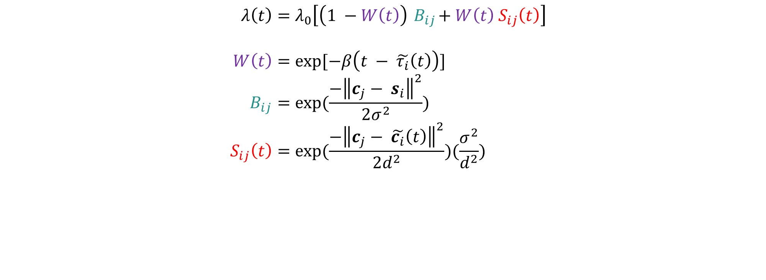
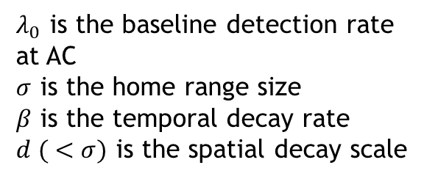
Detection Rate Equations
$$λ\left(t\right)=λ_{0}\left[\left(1 −W\left(t\right)\right){ B}_{ij}+W\left(t\right){ S}_{ij}\left(t\right)\right] \\ a=b \\ W\left(t\right)=exp⁡[−β\left(t − \tilde{τ_{i}}\left(t\right)\right)] \\ B_{ij}=exp⁡(\frac{−{\left\|c_{j}− s_{i}\right\|}^{2}}{2σ^{2}}) \\ S_{ij}\left(t\right)=exp⁡(\frac{−{\left\|c_{j}− \tilde{c_{i}}\left(t\right)\right\|}^{2}}{2d^{2}})(\frac{σ^{2}}{d^{2}})$$
$λ_{0}$ is the baseline detection rate at AC
$σ$ is the home range size
$β$ is the temporal decay rate
$d ( <σ)$ is the spatial decay scale
$\tilde{c_{i}}\left(t\right)$ is the location of the camera where animal i was last detected before t
$\tilde{τ_{i}}\left(t\right)$ is the time of that detection

Slide 17
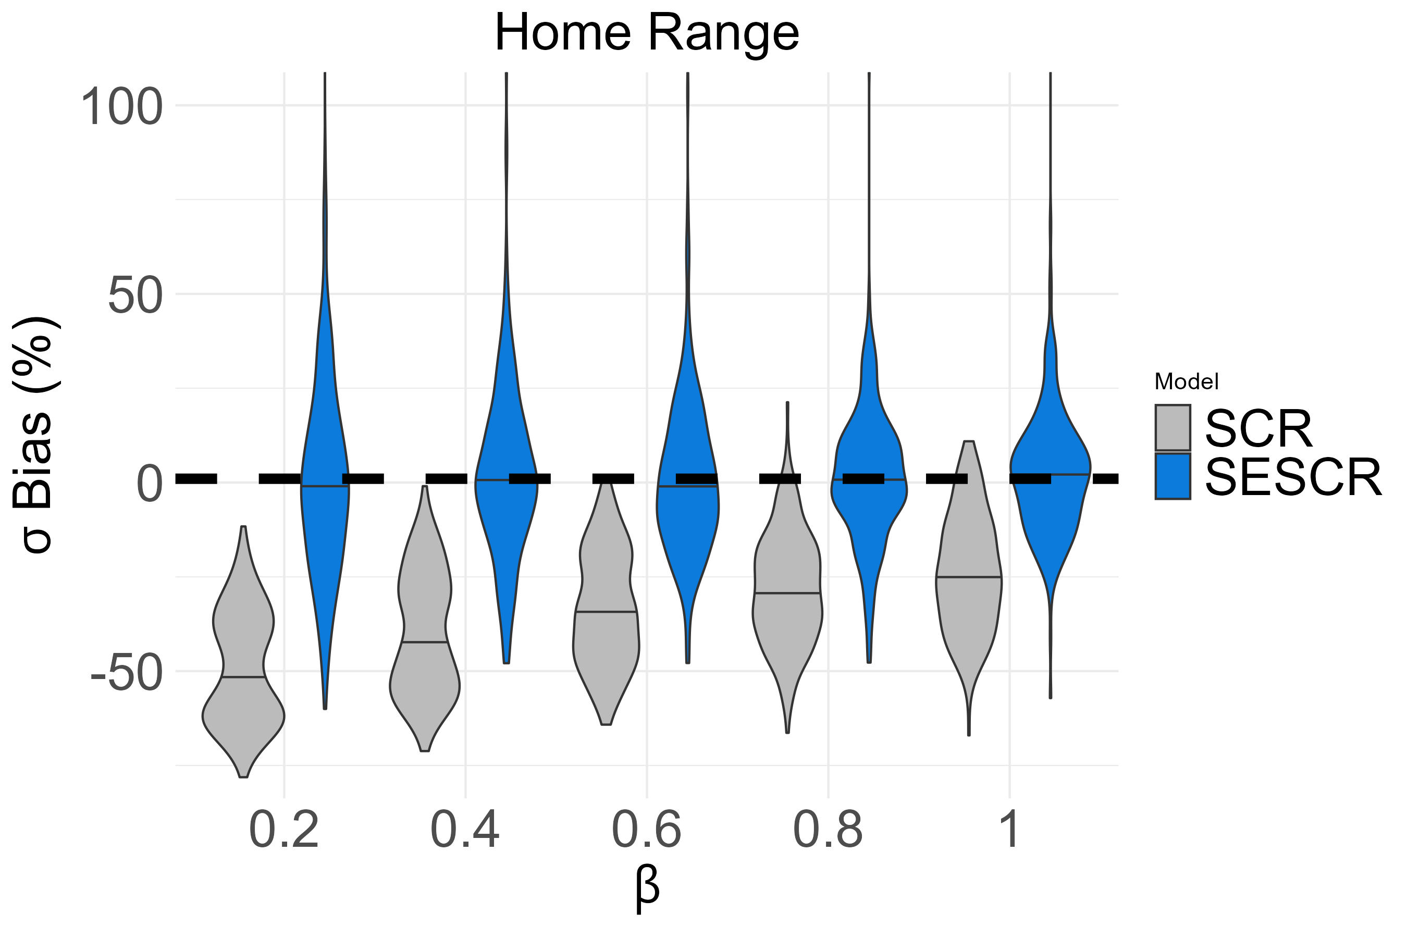
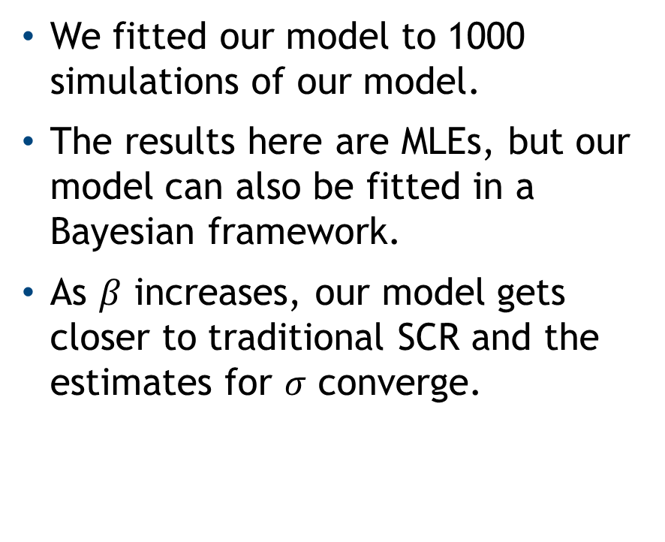
Simulation Study
We fitted our model to 1000 simulations of our model.
The results here are MLEs, but our model can also be fitted in a Bayesian framework.
As $β$ increases, our model gets closer to traditional SCR and the estimates for $σ$ converge.

Slide 18
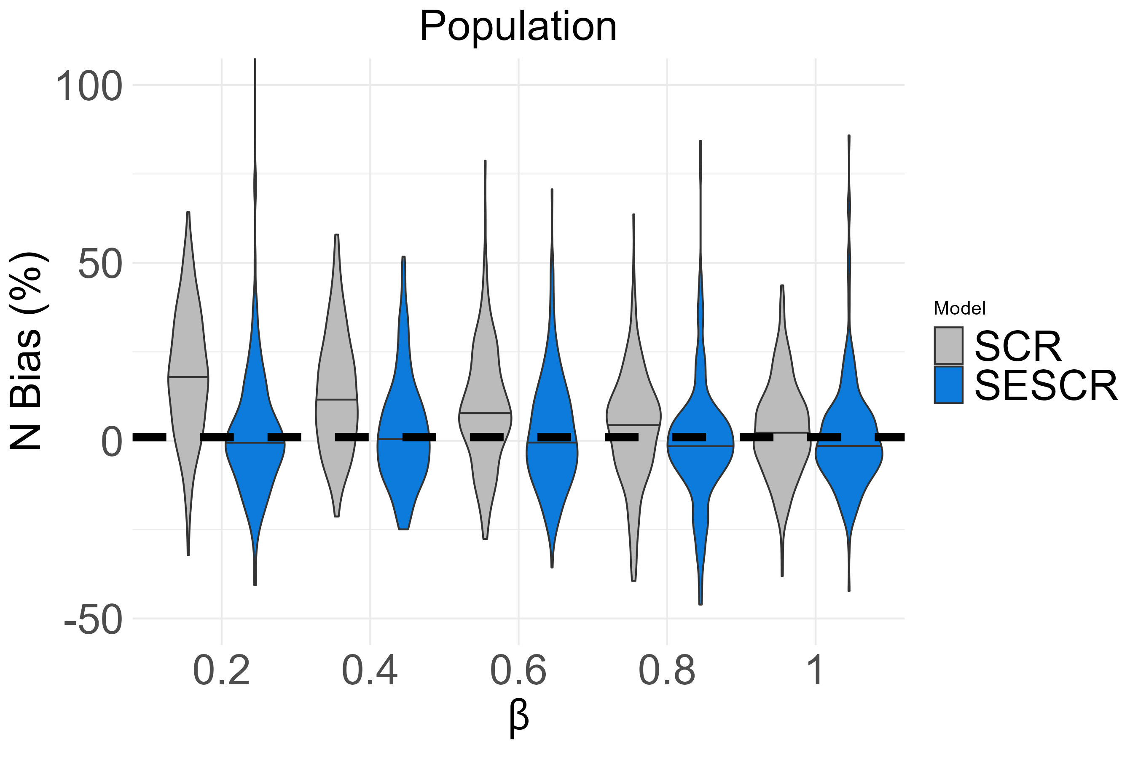
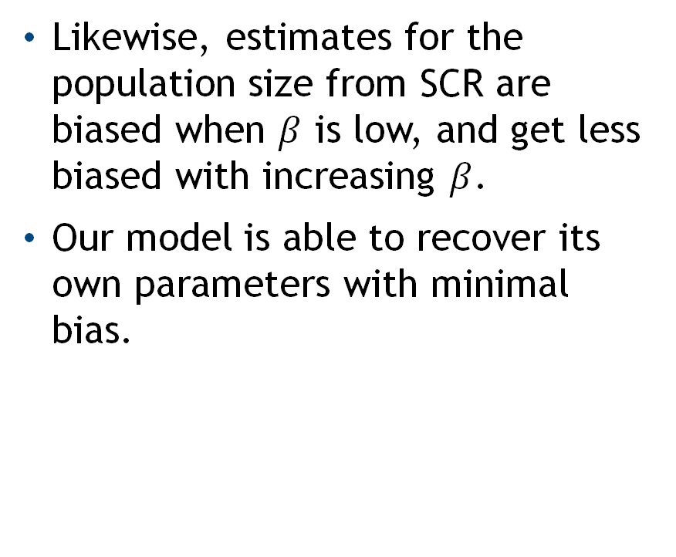
Simulation Study II
Likewise, estimates for the population size from SCR are biased when $β$ is low, and get less biased with increasing $β$.
Our model is able to recover its own parameters with minimal bias.

Slide 19
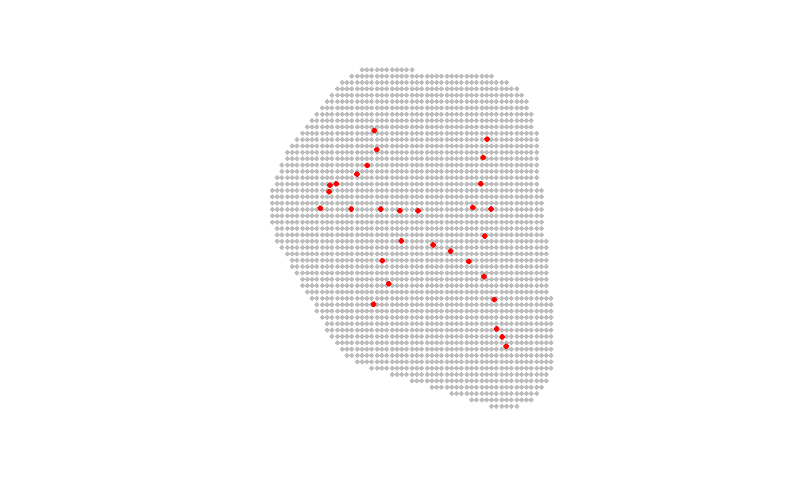
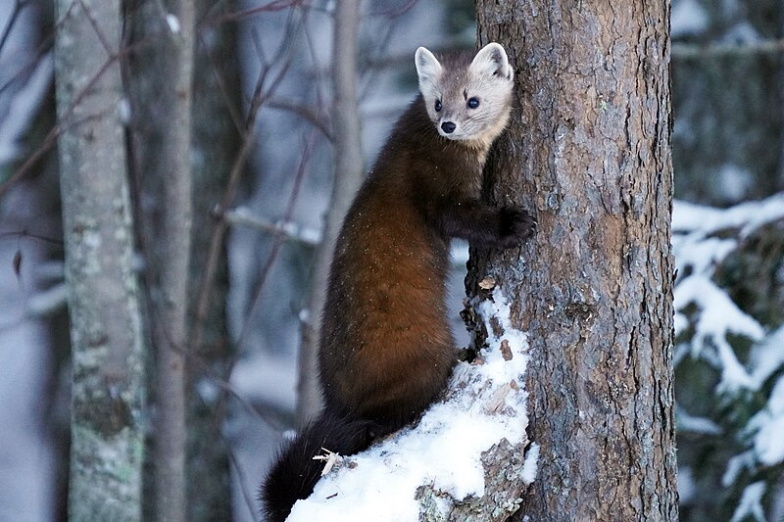
Case Study: American Martens
In 2017, a camera trap survey for American Martens (Martes americana) was performed in New Hampshire, USA for 11 days.
Times of detections recorded to nearest minute.
30 cameras.
9 observed individuals.
74 detections.
Panchaud, C., King, R., Borchers, D., Worthington, H., Durbach, I., & van Dam-Bates, P. (2025). Incorporating Memory into Continuous-Time Spatial Capture-Recapture Models. arXiv preprint arXiv:2408.17278

Slide 20
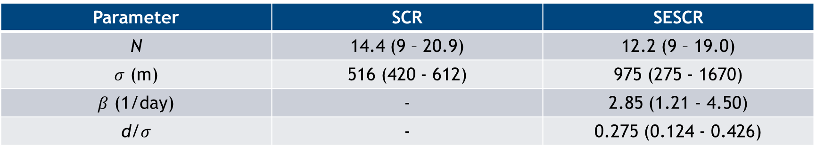
Marten Results
Parameter | SCR | SESCR
N | 14.4 (9 – 20.9) | 12.2 (9 – 19.0)
$σ$ (m) | 516 (420 - 612) | 975 (275 - 1670)
$β$ (1/day) | - | 2.85 (1.21 - 4.50)
d/$σ$ | - | 0.275 (0.124 - 0.426)
Our model gives a lower estimate for population than SCR, through both confidence intervals are wide.
The estimated home range size is bigger according to our model, as observed in simulation studies.
We get additional inference about animal movement.
Notes:
1000 units = 3128 utm

Slide 21

Conclusion
Animal movement means that captures of the same individual cannot be independent.
Our proposed model SESCR makes more realistic assumptions about animal movement and the effect of this on captures.
Simulation studies show that SESCR gives better estimates for abundance and home range size.
We are currently working on Goodness of Fit for our model.
alec.van.helsdingen@auckland.ac.nz

